Slide 1
Putting the Brakes on Human Trafficking: Legal Trends and Updates
Judge Gayle Williams-Byers (Ret.)
Judicial Fellow
National Judicial College
June 1, 2023

Slide 2
Learning Objectives
After this webcast, you will be better able to:
Identify and define forms of human trafficking;
Understand and apply human trafficking laws and penalties relative to CDL holders, and,
Recognize human trafficking indicators.

Slide 3
Where are you from?

Slide 4
Defining the Problem Human Trafficking Affects Everyone https://www.youtube.com/watch?v=35uM5VMrZas

Slide 5
Human Trafficking In a Nutshell
Form of modern-day slavery that involves the exploitation of persons for commercial sex or forced labor
Often involves crossing an international border but does not require movement
Traffickers use force, fraud, or coercion to control their victims

Slide 6
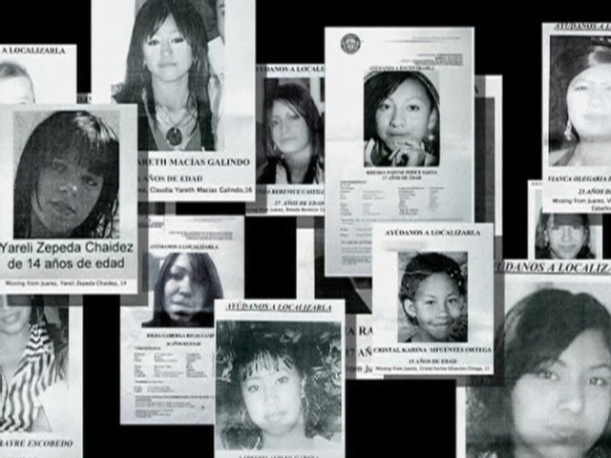
Women Make Up 70% of Trafficked Victims Worldwide

Slide 7
Human Trafficking: A Lucrative Business
Yields an estimated $150 billion in profits each year worldwide
An estimated $9 – $12 billion earned in the United States (more money than Microsoft or Apple earn annually)
Notes:
Human trafficking yields an estimated $31 billion in profits each year
An estimated $9 – $12 billion earned in the United States
After drug trafficking, human trafficking is the most lucrative business for organized crime
Becoming a preferred business for criminal syndicates around the world
Human workers, once purchased, will continue to provide profit due to their ability to work for months and even years to come.
Drugs, guns, other illegal materials, and humans can all be easily transported in the same manner.
(United Nations Office of Drug and Crime)

Slide 8
Guess the Competitor
Human Trafficking is second only to this illegal organized crime for being the most lucrative
Cyber Crimes
Drug Trafficking
Illegal Gambling
Notes:
My notes here

Slide 9
Human Trafficking as an Organized Crime
After drug trafficking, human trafficking is the most lucrative business for organized crime
Unlike drugs, humans can and are often resold again and again

Slide 10
The Seven Myths of Human Trafficking
This Photo by Unknown Author is licensed under CC BY-NC-ND

Slide 11
Myth #1: Human Trafficking Does Not Happen In The United States
Fact: Human Trafficking exists in every country, including the U.S. It is nationwide, in cities, suburbs and rural towns. No place is exempt.

Slide 12
Myth #2: Human Trafficking Victims are either Foreign Born or Poor People
Fact: Human Trafficking victims can range in age, race, gender, nationality or socioeconomic group.
This Photo by Unknown Author is licensed under CC BY-SA-NC

Slide 13
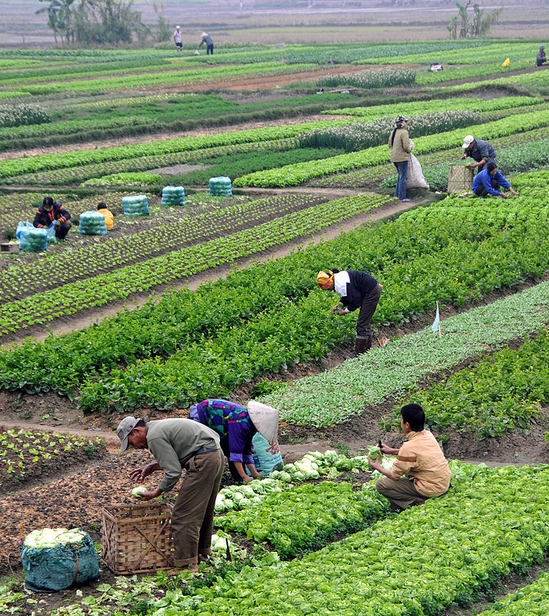
Myth #3: Human Trafficking is only Sex Trafficking
Fact: Human Trafficking encompasses both sex and labor trafficking which involves the exploitation of people. Victims can be found in industries such as sweatshops, massage parlors, hotels, agriculture, restaurants, hotels and domestic service.
This Photo by Unknown Author is licensed under CC BY-SA

Slide 14
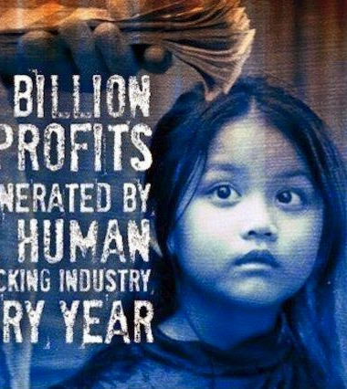
Myth #4: People must be forced or coerced into commercial sex acts to be considered victims of Human Trafficking
Fact: Under federal law, any minor under the age of 18 who is induced to perform commercial sex is a victim of human trafficking
This Photo by Unknown Author is licensed under CC BY-SA-NC

Slide 15
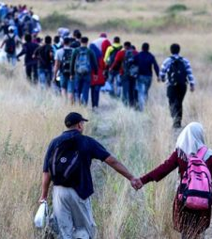
Myth #5: Human Trafficking and Human Smuggling are the Same
Fact: These are not the same. “Trafficking” is based on exploitation and does not require movement across borders. Smuggling involves movement of a person across a country’s borders with that person’s consent in violation of immigration laws.
This Photo by Unknown Author is licensed under CC BY-SA-NC

Slide 16
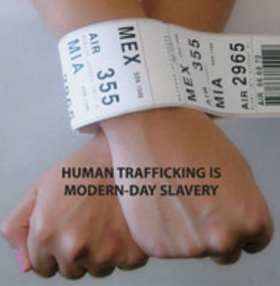
Myth #6: Human Trafficking Victims Will Try to Get Help When in Public
Fact: Victims are not likely to seek help when in public for fear of harm to themselves or their family. Also, they may no longer be in possession of their identification documents.
This Photo by Unknown Author is licensed under CC BY-SA-NC

Slide 17
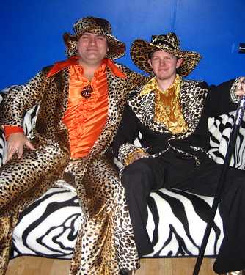
Myth #7: Human Trafficking “Pimps” are easily recognizable
Fact: Human Trafficking ”pimps” do not fit the ”traditional” profile. They range from housewives and truck drivers to pastors and professionals.
This Photo by Unknown Author is licensed under CC BY-NC-ND

Slide 18
The Modern-day “Pimp” Looks Like This……

Slide 19
Prostitution 30 Yrs Ago: Streetwalking

Slide 20
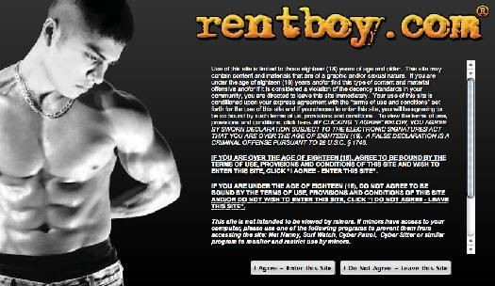
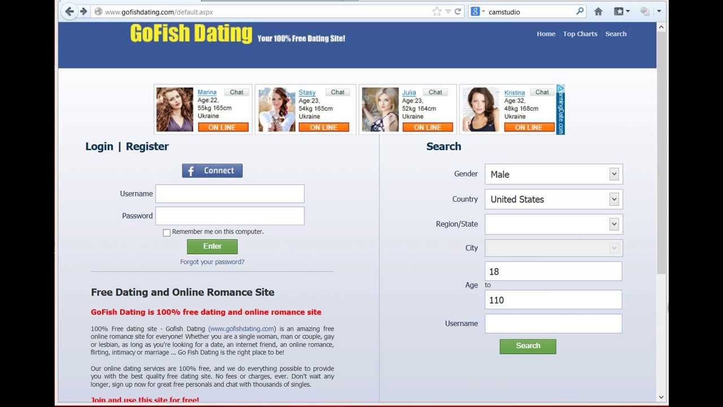
Now: Internet’s Virtual Streetcorner

Slide 21
2019: Internet’s Virtual Street Corner

Slide 22
Domestic Minor Sex Trafficking
U.S. age of entry into prostitution is often 13-15 years old
Children are being groomed into prostitution

Slide 23
Largest Number of Sex Trafficking Victims in the U.S.
An estimated 100,000+ victims annually
Many resort to “survival sex”
Often have history of involvement in state delinquency and dependency systems

Slide 24
Trafficking Recruitment
What are some of the most common online sites and domestic locations used for recruiting trafficking victims?
Online Websites |  | Domestic Locations
Notes:
NJC designed this slide for an audience of 16 or fewer. Each participant will select one of the 16 rectangles (using the pointer tool), and then type their own responses using the text tool.

Slide 25
Among The Winners Are……
Online Websites
Domestic Locations
Kik
Instagram
Facebook
Meetme
Twitter
Schools
Group homes
Foster Care
Shopping Malls
Bus Stops

Slide 26
2012 Alex Campbell Case (Chicago)

Slide 27
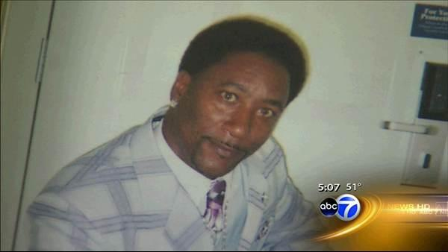
“Businessman” Alex Campbell

Slide 28
Campbell Case (Chicago)
Chicago native Alex Campbell convicted on January 30, 2012 on sex trafficking and labor trafficking charges
Operated three massage parlors in suburban Chicago
Used the internet and scoured the streets to identify primarily foreign young women with illegal immigration status to traffic in labor and sex

Slide 29
Campbell Case
Investigation began when one victim contacted ICE after attempting to “buy” her way out of his control
Victim was told it would cost her more than $30,000 to leave “The Family”
More than 20 victims in total were identified – several were forced to “advertise” on Craigslist “personals” for “appointments"

Slide 30
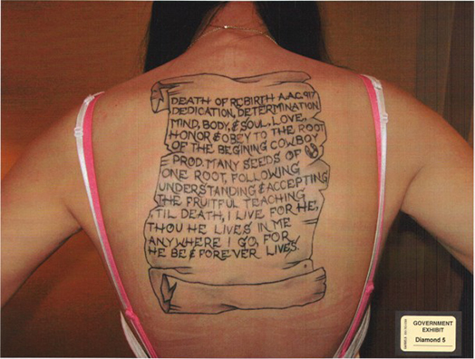
The “Branding” of His Victims

Slide 31
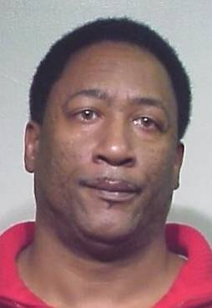
Campbell Case
Governed by ”The Pimp’s Bible” – given life sentence in 2013
Judge cited the brutality of the exploitation and lifelong scars victims will bear

Slide 32
The Foundational Framework of Human Trafficking
Not a new crime, but laws regulating it are relatively new
2000 Congress passed the Traffic Victims Protection Act (TVPA)
first piece of legislation that made human trafficking a federal crime

Slide 33
The Foundational Framework of Human Trafficking
TVPA of 2000 Breaks Human Trafficking into 3 Primary Elements
Actions/Means/Purpose
The combination of these are necessary to prove the offense and thus secure a conviction for the crime

Slide 34
The Foundational Framework of Human Trafficking
Action: Recruiting, Harboring, Transporting, Providing, Obtaining or even advertising

Slide 35
The Foundational Framework of Human Trafficking
Action: Recruiting, Harboring, Transporting, Providing, Obtaining or even advertising
Means: Force, Fraud or Coercion

Slide 36
The Foundational Framework of Human Trafficking
Action: Recruiting, Harboring, Transporting, Providing, Obtaining or even advertising
Means: Force, Fraud or Coercion
Purpose: Labor exploitation or sexual exploitation

Slide 37
The Foundational Framework of Human Trafficking
Are there any exceptions to these elements? YES!
Anyone under the age of 18 is not required to prove force, fraud or coercion
There is no such thing as a ”child prostitute” and child labor laws are strictly enforced in the U.S. therefore they are prima facie child victims.

Slide 38
No Human Trafficking On Our Roads Act Effective September 2019

Slide 39
It’s Here in the United States
Location of potential human trafficking cases reported to the National Human Trafficking Center (updated July 30, 2020)

Slide 40
No Human Trafficking On Our Roads Act
Referred to as “The Act”
Revised the list of offenses eligible for permanent disqualification of a CDL for certain offenses to include a conviction for Human Trafficking in a CMV.
This is a lifetime disqualification/suspension with the CDL holder ineligible for reinstatement.

Slide 41
No Human Trafficking On Our Roads Act
Lifetime Disqualification for CDL Holders:
The amendment to include Human Trafficking as a lifetime disqualifying offense was a rule expansion.
CDL holders are aware of additional lifetime disqualifying events/offenses at the time of licensure.

Slide 42
No Human Trafficking On Our Roads Act
Rule intended to be a deterrent:
Human Trafficking (especially sex trafficking) is considered to be particularly prevalent at commercially and State operated truck stops.
Locations are often remote where trafficking can go undetected.
CMV drivers have the ability to both identify and assist in thwarting trafficking behavior by alerting law enforcement to suspicious behavior at these locations.

Slide 43
No Human Trafficking On Our Roads Act
National Compliance
States are required to come into substantial compliance with this new rule (requiring Human Trafficking convictions to be a lifetime disqualifying offense for CDL holders) “as soon as practicable”
But no later than three (3) years from the effective date of the final rule (i.e. September 23, 2019
Because Human Trafficking is so pervasive, most States are obliged to comply.

Slide 44
Yes
No
Has your State substantially complied with adopting this new rule?
Maybe
I don’t know

Slide 45
Why Compliance Works: Sorenson and Hodza

Slide 46
Truckers Take on Human Trafficking
Jan. 2015, Kevin Kimmell taking break at VA truck stop
Noticed RV, rocking with blackened curtains
ALERT: face of young woman, jerked away
Action: called police
Meet Kevin Kimmell…. https://www.youtube.com/watch?v=CjUnjBmvyI0

Slide 47
Human Trafficking: Indicators
Signs of malnutrition, psychological and/or physical abuse
Appearance is unkempt, body odor and wearing the same clothing (unlaundered)
Has few or no personal belongings (particularly identification.)
Rarely allowed to travel alone; is often accompanied by someone or is dropped off and picked up.

Slide 48
Human Trafficking: What to Ask
Do you keep your own money?
Does your family know where you are or how to contact you? When was the last time you saw them?
Are you or have you been physically abused?
Has anyone threatened you or your family? What are the threats?

Slide 49
Discussion Table
While traveling with your family on vacation, you stop at a rest area. While in the restroom, you see a shaking young woman at the sink. She has a black eye, bodily bruising and is gaunt. On your way out, a man yells into the bathroom, “hurry up so you can get back to work!” What do you do?
Notes:
NJC designed this slide for an audience of 16 or fewer. Each participant will select one of the 16 rectangles (using the pointer tool), and then type their own responses using the text tool.

Slide 50
Human Trafficking: What to Do
Alert a store manager or clerk (many are trained in how to respond)
Contact law enforcement directly and report suspected trafficking
Collect the make, model, color and license plate of the vehicle
DO NOT ATTEMPT a personal rescue or intervention. This can pose a risk of danger to yourself or the victim.

Slide 51
Impact: Trauma Trafficking
PTSD symptoms:
Nightmares & flashbacks
Unexplained mood swings
Anxiety & depression
Dissociation
Hypervigilance
Distorted sense of “normal”

Slide 52
Trafficking Victims in Court
Victim may not self identify as victim
May “block out” painful memories
Victim’s story may change over time
Victim may try to protect his/her trafficker or refuse to testify against them

Slide 53
Resources
National Human Trafficking Hotline
1-888-373-7888
Or any of these government or government-affiliated sites:
www.justice.gov
OJJDP.OJP.gov
DHS.gov
Polarisproject.org

Slide 54
Thank You!

